Slide 1

GLOBAL INSTITUTE OF TECHNOLOGY
Department of
Computer Science & Engineering
Subject Name with code: Data Structure & Algorithms
Unit-3
Presented by: Mr. Sohan Lal Gupta
Assistant Professor, CSE

Slide 2
GLOBAL INSTITUTE OF TECHNOLOGY JAIPUR
Data Structure & Algorithms
CSE/ III Sem
Index
3.4.6 Merge Sort
3.4.7 Radix Sort
3.4.8 Counting Sorting
Sohan Gupta

Slide 3
3.4.6 merge sort
GLOBAL INSTITUTE OF TECHNOLOGY JAIPUR
Data Structure & Algorithms
CSE/ III Sem
Merge sort is a sorting technique based on divide and conquer technique
Merge sort first divides the array into equal halves and then combines them in a sorted manner.
breaking down a list into several sub-lists until each sublist consists of a single element
merging those sublists in a manner that results into a sorted list.
Sohan Gupta

Slide 4
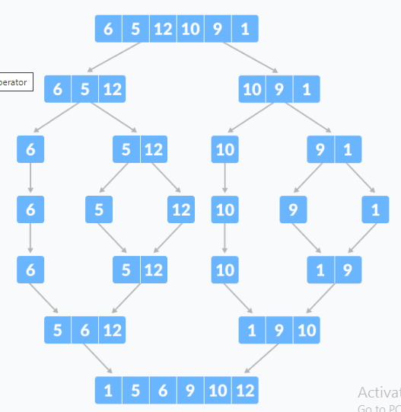
GLOBAL INSTITUTE OF TECHNOLOGY JAIPUR
Data Structure & Algorithms
CSE/ III Sem
Sohan Gupta

Slide 5
GLOBAL INSTITUTE OF TECHNOLOGY JAIPUR
Data Structure & Algorithms
CSE/ III Sem
Time Complexity:
Best Case Complexity: O(n*log n)
Worst Case Complexity: O(n*log n)
Average Case Complexity: O(n*log n)
Space Complexity
The space complexity of merge sort is O(n).
Merge Sort Applications
Inversion count problem
External sorting
E-commerce applications
Sohan Gupta

Slide 6
GLOBAL INSTITUTE OF TECHNOLOGY JAIPUR
Data Structure & Algorithms
CSE/ III Sem
Algorithms for Merge sort:
Step 1 − if it is only one element in the list it is already sorted, return.
Step 2 − divide the list recursively into two halves until it can no more be divided.
Step 3 − merge the smaller lists into new list in sorted order.
Sohan Gupta

Slide 7
GLOBAL INSTITUTE OF TECHNOLOGY JAIPUR
Data Structure & Algorithms
CSE/ III Sem
3.4.7 Radix Sort
radix sort is a non- Comparative sorting algorithms
It avoids comparison by creating and distributing elements into buckets according to their radix
radix sort has also been called bucket sort and digital sort.
Sohan Gupta

Slide 8
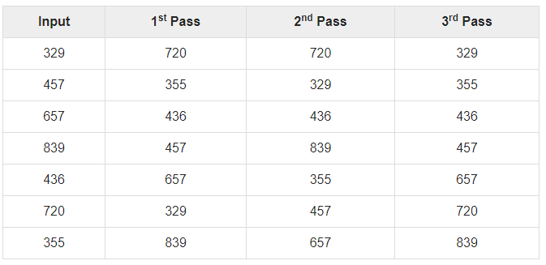
GLOBAL INSTITUTE OF TECHNOLOGY JAIPUR
Data Structure & Algorithms
CSE/ III Sem
Following example shows how Radix sort operates on seven 3-digits number.
Sohan Gupta

Slide 9
GLOBAL INSTITUTE OF TECHNOLOGY JAIPUR
Data Structure & Algorithms
CSE/ III Sem
Time complexity is O(d(n+k)).
Here, d is the number cycle and O(n+k) is the time complexity of counting sort.
Radix Sort Applications
Radix sort is implemented in
DC3 algorithm (Kärkkäinen-Sanders-Burkhardt) while making a suffix array.
places where there are numbers in large ranges.
Advantages :
1. Fast when the keys are short i.e. when the range of the array elements is less.
2. Used in suffix array constuction algorithms like Manber's algorithm and DC3 algorithm.
Disadvantages:
1. Since Radix Sort depends on digits or letters, Radix Sort is much less flexible than other sorts. Hence , for every different type of data it needs to be rewritten.
2. The constant for Radix sort is greater compared to other sorting algorithms.
3. It takes more space compared to Quicksort which is inplace sorting.
Sohan Gupta

Slide 10
GLOBAL INSTITUTE OF TECHNOLOGY JAIPUR
Data Structure & Algorithms
CSE/ III Sem
Radix sort algorithm -
Step 1 - Define 10 queues each representing a bucket for each digit from 0 to 9.
Step 2 - Consider the least significant digit of each number in the list which is to be sorted.
Step 3 - Insert each number into their respective queue based on the least significant digit.
Step 4 - Group all the numbers from queue 0 to queue 9 in the order they have inserted into their respective queues.
Step 5 - Repeat from step 3 based on the next least significant digit.
Step 6 - Repeat from step 2 until all the numbers are grouped based on the most significant digit.
Sohan Gupta

Slide 11
3.4.8 Counting sorting
GLOBAL INSTITUTE OF TECHNOLOGY JAIPUR
Data Structure & Algorithms
CSE/ III Sem
Counting sort is a stable sorting technique (which is used to sort objects according to the keys that are small numbers.)
Counting sort is a sorting algorithm that sorts the elements of an array by counting the number of occurrences of each unique element in the array.
The count is stored in an auxiliary array and the sorting is done by mapping the count as an index of the auxiliary array.
It counts the number of keys whose key values are same.
This sorting technique is effective when the difference between different keys are not so big, otherwise, it can increase the space complexity
Sohan Gupta

Slide 12
Example: For simplicity, consider the data in the range 0 to 9.
Input data: 1, 4, 1, 2, 7, 5, 2 1)
GLOBAL INSTITUTE OF TECHNOLOGY JAIPUR
Data Structure & Algorithms
CSE/ III Sem
Take a count array to store the count of each unique object.
Index: 0 1 2 3 4 5 6 7 8 9
Count: 0 2 2 0 1 1 0 1 0 0
2. Modify the count array such that each element at each index stores the sum of previous counts.
Index: 0 1 2 3 4 5 6 7 8 9
Count: 0 2 4 4 5 6 6 7 7 7
The modified count array indicates the position of each object in the output sequence.
3. Output each object from the input sequence followed by decreasing its count by 1. Process the input data: 1, 4, 1, 2, 7, 5, 2. Position of 1 is 2. Put data 1 at index 2 in output. Decrease count by 1 to place next data 1 at an index 1 smaller than this index.
Sohan Gupta

Slide 13
GLOBAL INSTITUTE OF TECHNOLOGY JAIPUR
Data Structure & Algorithms
CSE/ III Sem
Time Complexities:
Worst Case Complexity: O(n+k)
Best Case Complexity: O(n+k)
Average Case Complexity: O(n+k)
Space Complexity: The space complexity of Counting Sort is O(max). Larger the range of elements, larger is the space complexity.
Counting Sort Applications:
Counting sort is used when:
there are smaller integers with multiple counts.
linear complexity is the need.
Sohan Gupta

Slide 14
GLOBAL INSTITUTE OF TECHNOLOGY JAIPUR
Data Structure & Algorithms
CSE/ III Sem
Advantages of Counting Sort:
It is quite fast
It is a stable algorithm
Note: For a sorting algorithm to be stable, the order of elements with equal keys (values) in the sorted array should be the same as that of the input array.
Disadvantages of Counting Sort:
It is not suitable for sorting large data sets
It is not suitable for sorting string values
Sohan Gupta

Slide 15

GLOBAL INSTITUTE OF TECHNOLOGY JAIPUR
Data Structure & Algorithms
CSE/ III Sem
Algorithms for Counting sort:
Step 1: Consider an input array A having n elements in the range of 0 to k, where n and k are positive integer numbers. These n elements have to be sorted in ascending order using the counting sort technique. Also note that A[] can have distinct or duplicate elements
Step 2: The count/frequency of each distinct element in A is computed and stored in another array, say count, of size k+1. Let u be an element in A such that its frequency is stored at count[u].
Step 3: Update the count array so that element at each index, say i, is equal to -
Step 4: The updated count array gives the index of each element of array A in the sorted sequence. Assume that the sorted sequence is stored in an output array, say B, of size n.
Step 5: Add each element from input array A to B as follows:
Set i=0 and t = A[i]
Add t to B[v] such that v = (count[t]-1).
Decrement count[t] by 1
Increment i by 1
Repeat steps (a) to (d) till i = n-1
Step 6: Display B since this is the sorted array
Sohan Gupta

Slide 16
GLOBAL INSTITUTE OF TECHNOLOGY JAIPUR
Data Structure & Algorithms
CSE/ III Sem
Thank You… .
Any Quries ?
Sohan Gupta

